Slide 1
Supervisor Meeting
G2-T6

Slide 2
Overview

Slide 3
Project Manager Schedule
Iteration | Week | Project Manager (PM)
1 | 5-6 | Regan (PM1) Aloysius (PM2)
2 | 7 | Aloysius
3 | 8-9 | Cheryl
4 | 10-11 | Huiyan
5 | 12 | Haseena

Slide 4
Project Milestones
Milestone | Week | Project Manager (PM)
Supervisor Meeting 1 | 6 (PM 2) | Aloysius
Project Manager Review | 7 | Aloysius
In Class Review | 9 | Cheryl
Supervisor Meeting 2 | 11 | Huiyan
User Acceptance Test | 12 | Haseena
Project Submission | 13 | Regan
Final Presentation | 14 | Regan

Slide 5
Project Development Sequence
Iteration 1
Iteration 2
Iteration 3 / 4
Iteration 5
Login
Admin Functionality
UAT Mitigation
Bootstrapping
Controller
Validation
Student Functionality
Buffer Coding TIme
DAOs
Database Input
Web Service
File Upload

Slide 6
Iteration Format
PP Coding
General meeting
Teaching/Sharing session
Testing
Function Review
Team meeting to discuss what are to be done in the following week
Prior to session, PM will allocate a specific aspect to research on and share findings
Testing of code against corner case and test case. Bugs are to be noted down.
Explanation of code done by PP pairs, and sharing of rational behind coding ideology.
Test Case Creation

Slide 7
Iteration 1
Overall
Breakdown :
Iteration | 1
Duration | 2 weeks
Date | 12/09/16 - 18/09/16
Project Manager | Regan
Coding Pair 1 | Cheryl, Aloysius
Coding Pair 2 | Haseena, Huiyan
Date | 19/09/16 - 25/09/16
Project Manager | Aloysius
Coding Pair 1 | Cheryl, Regan
Coding Pair 2 | Haseena, Huiyan
Work Hours
Regan | 21
Aloysius | 23
Cheryl | 23
Huiyan | 22.5

Slide 8
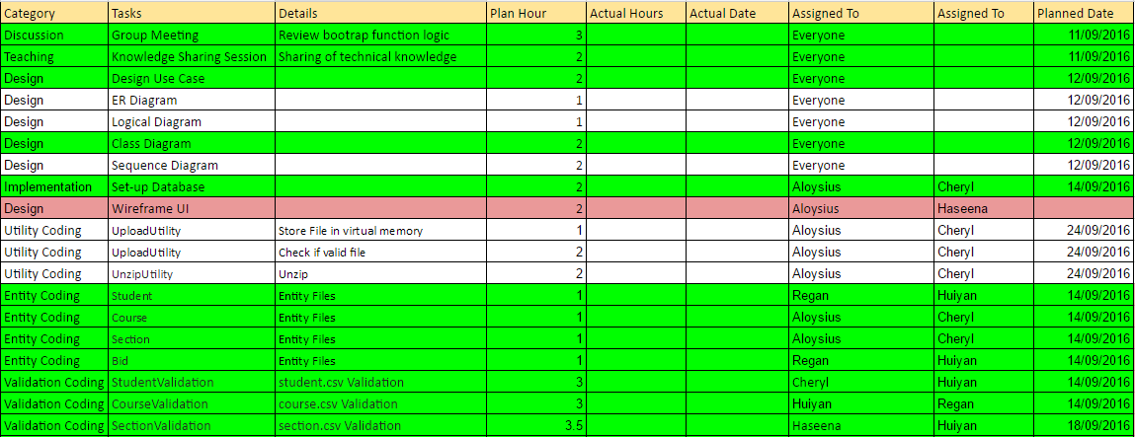
Iteration 1 : Schedule

Slide 9
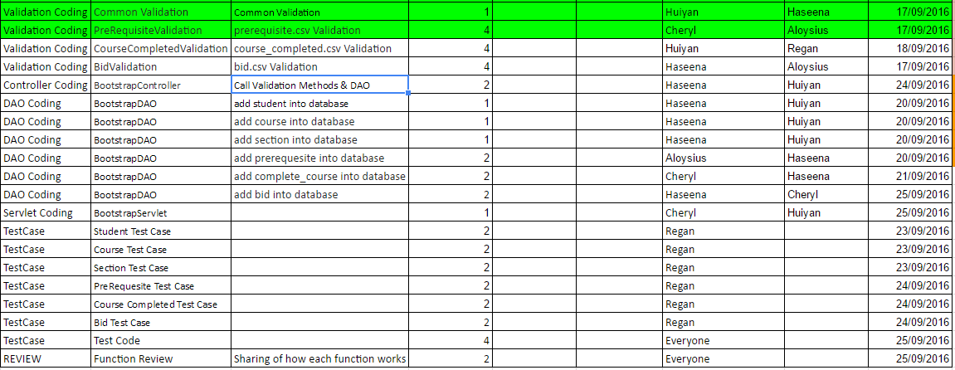
Iteration 1 : Schedule

Slide 10
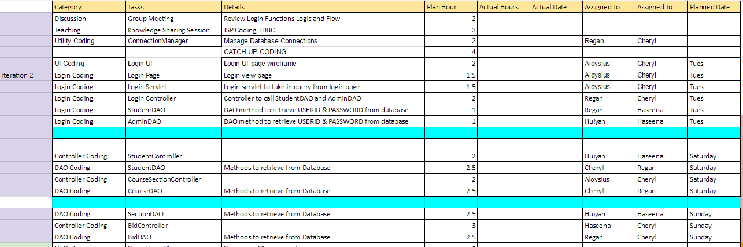
Iteration 2
Note: Anticipating some carry-over task to be completed on Monday

Slide 11
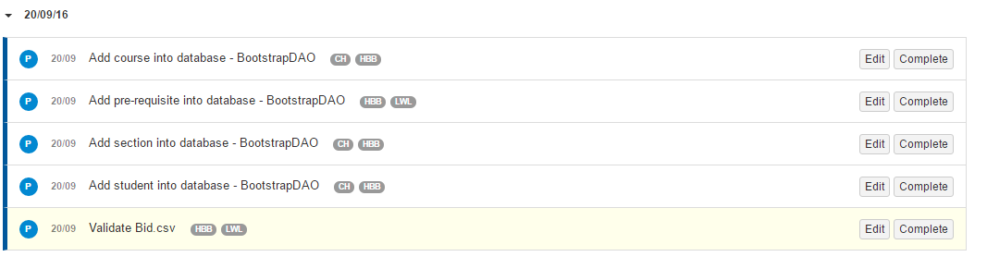
Project Schedule Status (on-going)
Behind time: 9 hours

Slide 12
Tracking

Slide 13
Pair Programming Hours Metrics (Iteration 1)
Task | Planned Hours | Actual Hours | PPM | Action
Create Course Entity | 1 | 0.67 | 1.50 | No action required
Create Student Entity | 1 | 1.1 | 0.91 | No action required
Create Section Entity | 1 | 1.17 | 0.86 | No action required
Validate course.csv | 3 | 2.92 | 1.03 | No action required
Create Bid Entity | 1 | 3.07 | 0.33 | For future task, PM must be informed about the start/end and duration of task before starting.
PPM | Action
0.5-1.5 | No action required
<0.5 | Re-estimate Review issues
>1.5 | Re-estimate Review issues

Slide 14
Pair Programming Hours Metrics (Iteration 1)
Task | Planned Hours | Actual Hours | PPM | Action
Validate student.csv | 3.0 | 2.63 | 1.14 | No action required
Setup database | 2 | 2.43 | 0.82 | No action required
Validate Prerequisite.csv | 4 | 2.5 | 1.60 | Re-estimate buffer time for coding sessions (Reduce)
Do common validations for all csv files | 1 | 0.97 | 1.03 | No action required
Validate Section.csv | 3.5 | 2.3 | 1.52 | Re-estimate buffer time for coding sessions (Reduce)
Validate Courses Completed.csv | 4 | 4.13 | 0.97 | No action required

Slide 15
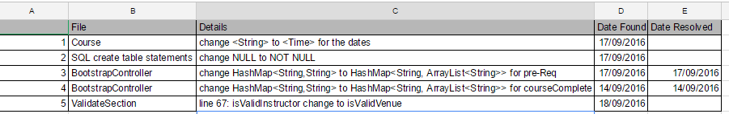
Bugs / Incident Documents
Bugs Tracking (For Project Member’s reference)
Incident Tracking (Learning points: serve as reminder of possible mistakes)

Slide 16
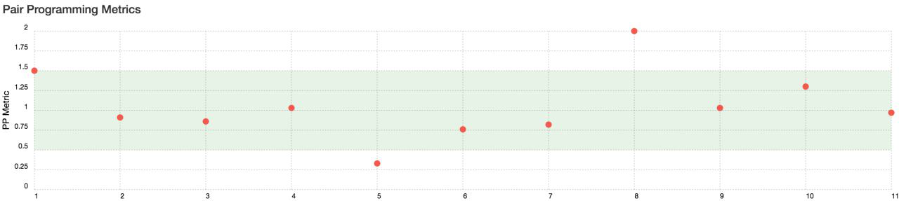
PPLog
Prerequisite Validation
Prerequisite Validation
Create Bid Entity

Slide 17
Schedule Metrics
Iteration | Planned Hours | Actual Hours | Score | Status
1 | 47.5 | ~28 | <Pending> | On-going
2 | 29 | - | - | Not Started
3 | 40 | - | - | Not Started
4 | 30 | - | - | Not Started
5 (UAT Week) | Tentative | - | - | Tentative

Slide 18
Issues

Slide 19
Issues
Schedule
Overestimated the task
Over-optimistic about clocking hours resulting in shifting to another dates.
PP-log Incidents
Forget to click complete button once we stop the task
Not familiar with PP-log
Metrics not showing correct information
Git Incidents
Pushing of code outside of session. (Reason: adding in checking of corner case)

Slide 20
Mitigation Plans

Slide 21
Mitigation Plans
Schedule
Use current coding speed/hours to benchmark future iterations. Changes to future iteration are made.
Identify high complexity tasks and allocate over reasonable timeframe (over two days or over a few task sessions)
Back-up plan when team members are not able to commit to planned coding session/date.
PP-log
For future tasks, PM must be informed about the start/end and duration of task before start.
PP-log to be checked by all team members regularly. PM to check in on pplog when programming pair inform PM that their session is done.

Slide 22
Questions for Supervisor
Can we have numbers in name ? (Do we make assumptions?)
Can we assume the schools are SMU faculties, ie. SIS, SOE, SOSS, SOA
Do we need to include web service in the use case/logical diagram
What can we push into GIT , non-programming tasks, database?, test cases, minutes.
Are we allowed to make code changes to completed tasks (to correct coding errors)?

Slide 23
End of Slides

